Slide 1
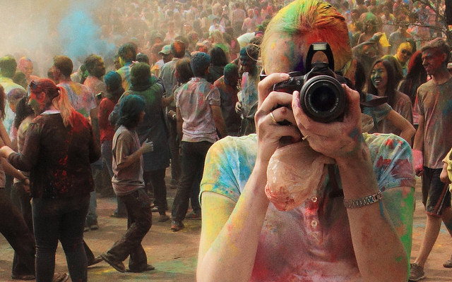
Week 2: Travel in the Media: journalism and blogging

Slide 2
Term 4, Week 2: travel journalism - blogging
Learning intentions:
Success criteria By the end of the week:
Define travel journalism, culture, blog
Understand task
understand the change in time in representation of cultures from British colonial times until now
understand the role of adjectives/ verbs/ figurative devices used in representing a culture and creating a positive and negative tone
Experiment with writing to represent a culture by changing verbs and adjectives
Define travel journalism, culture, blog
Understand and experiment with creating tone
Compare vocabulary used to create positive and negative tone
Identify features of blog on Education perfect
Analyse features of blogs on stile app
Create blog and start post 1

Slide 3



Travelling
What do travellers go to a location for?
Culture
Sports
Wildlife
History
Brainstorm
Reflect
What entices a traveller to visit a location?
Where would you like to travel to, that you haven’t been before?
What makes you want to go there?

Slide 4
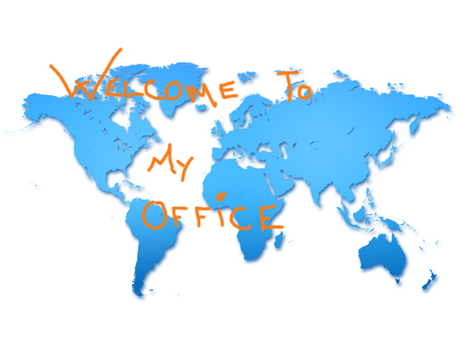
Travel journalism
Overtly informative
review-like in style,
offers insights into experiences to inform a would-be traveler
Journalist must bring the destination to life, in order to inform the audience
Involves:
‘selling’ a culture or reason to visit to others
Recounts of experiences with details like cost, transport, routes, options, cautions
Being tailored to the audience (customised)

Slide 5
Representing cultures
Culture:
‘the customary beliefs, social forms, and material traits of a racial, religious, or social group’ (Merriam-Webster, 2018)
‘the characteristic features of everyday existence (such as diversions or a way of life) shared by people in a place or time’ (Merriam-Webster, 2018)
Days of the British Empire
Contemporary views
Viewed other countries’ cultures as being uncivilized or primitive
Culture of those in power (Brits) were seen as superior (everyone else needed to conform – language, customs, religion, etc.)
Many cultures who were deemed ‘inferior’ lost their customs, language, dialects and other forms of individualization. This was particularly due to cultural misrepresentation, and stereotypes
Travel writers try to represent visited cultures fairly, to see their cultural practices and traditions as equal to their own
Not all writers succeed; they may be seen as patronizing, insensitive or derogatory

Slide 6
Representing culture
‘Life on the Nile’ by Veronica Matheson
Change
List
Read
Re-write
‘Life on the Nile’
Cultural representation
Rewrite a few sentences of the text with a different perspective of cultural representation
Read the excerpt by Veronica Matheson
How is the Egyptian culture represented? Make 5 dot points about this.

Slide 7
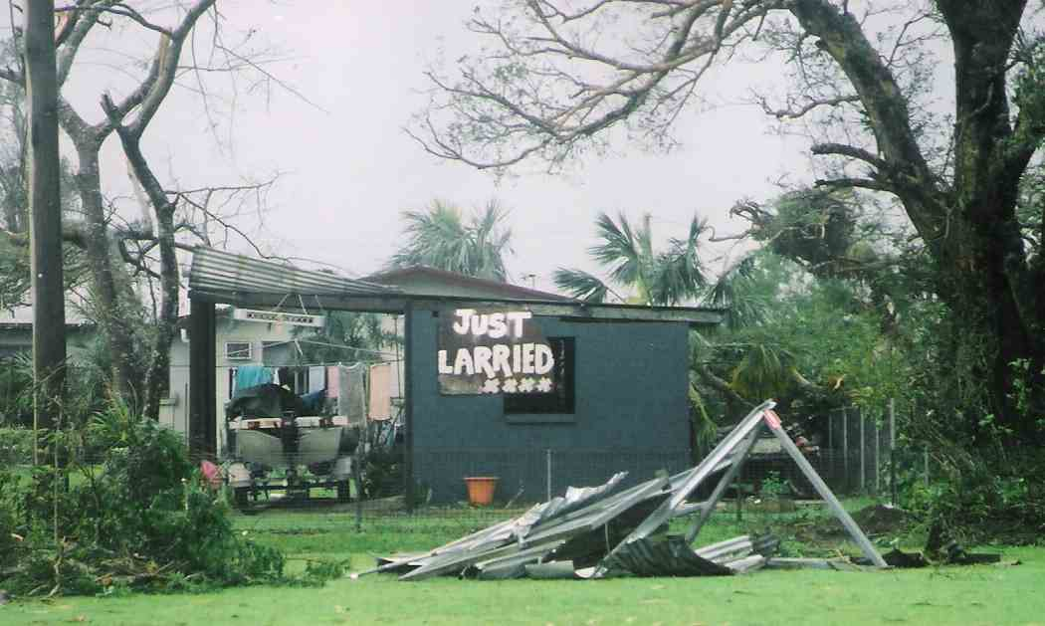
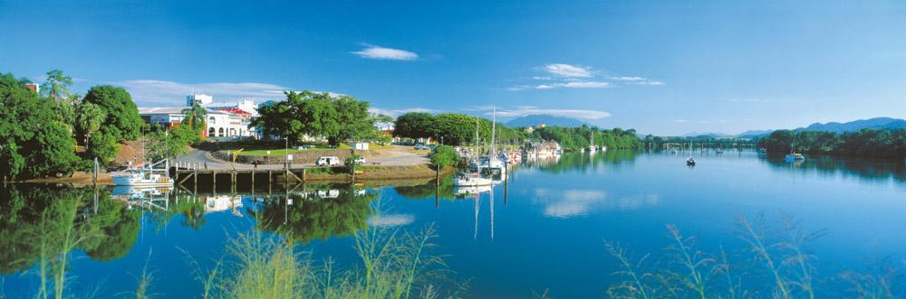
Reviewing Far North Queensland
Positive
Negative
Select a location near where you live and write a positive review about it.
What is a good feature?
Why do you like being there?
Based on the same location, twist your review around to write a negative review.
What is not so good about it?
Why would you recommend people not going there?
Draw a Venn diagram in your books to compare the positive and negative language used.
What are the positive words that represent the place well?
What negative connotations do you use to show somewhere is not up to scratch?

Slide 8
Thursday Week 2: travel journalism - blogging
Learning intentions:
Success criteria By the end of the week:
Define blog
Understand task
understand the change in time in representation of cultures from British colonial times until now
understand the role of adjectives/ verbs/ figurative devices used in representing a culture and creating a positive and negative tone
Experiment with writing to represent a culture by changing verbs and adjectives
Define blog, blogging blogger
Understand and experiment with creating tone by comparing vocabulary used to create positive and negative tone
Identify features of blog on Education perfect
Analyse features of blogs on stile app
Create blog and start post 1

Slide 9
Reviewing Far North Queensland
Positive
Negative
Select a location near where you live and write a positive review about it.
What is a good feature?
Why do you like being there?
Based on the same location, twist your review around to write a negative review.
What is not so good about it?
Why would you recommend people not going there?
Draw a Venn diagram in your books to compare the positive and negative language used.
What are the positive words that represent the place well?
What negative connotations do you use to show somewhere is not up to scratch?

Slide 10

Term Blog :
Noun:
a regular record of your thoughts, opinions, or experiences that you put on the internet for other people to read:
She writes a food blog in which she shares recipes, tips, and restaurant reviews.
Verb: to write or add material to a blog:
She blogs about fashion.
Blogger (noun) is one who blogs
BLOG | meaning in the Cambridge English Dictionary. (2019). Dictionary.cambridge.org. Retrieved 13 October 2019, from https://dictionary.cambridge.org/dictionary/english/blog

Slide 11
Some blog examples:
Professional
https://www.travelmoneyoz.com/blog/destination-essentials/travel-hacks-beginners-guide-philippines
As a class we will look at this example and note the stylistic features (format) and some language features.
Student:
https://spark.adobe.com/page/osIlQd0PNrKhN/
In pairs you will look at this example and identify the stylistic features (format) and some language features.

Slide 12

Homework: due Friday.
Find a list of top 10 bloggers and find your favourite.
Find a how –to-blog website to bookmark and scan it for information.
Explain why it is your favourite.

Slide 13
Go to Education Perfect to complete a lesson on blogging.
Aim: check understanding of blog by identifying blogs.

Slide 14
Go to stileapp.com/join CLASS CODE W4RHC7 to complete a lesson on blogging.
Aim: analyzing features of blogs.

